Slide 1
Amazon Sale Analysis

Slide 2
Introduction
Objective
Benefits
Problem Statement
Sales management has gained importance to meet increasing competition and the need
for improved methods of distribution to reduce cost and to increase profits. Sales
management today is the most important function in a commercial and business
enterprise.
Help out to make better business decisions.
Help analyze customer trends and satisfaction, which can lead to new and better products and services.
Gives better insight of customers base.
Helps in easy flow for managing resources.
Develop a Report by Extracting-Transforming-Loading of data which contains Sales trend with respect to Year, Month, Quarter and find Some relationships through data to understand and Analyze the Facts.

Slide 3
Quick Insight
13.37M
Total Sales
44.16M
Total Profit
639
Products

Slide 4
Main KPIs
Total Sales – Total sales from 2010 to 2017
Total Revenue – Revenue from 2010 to 2017
Total Profit – Total profit throughout the years
Total Products – Total products sales
Sales by Month and Year – Trends of sales year wise

Slide 5
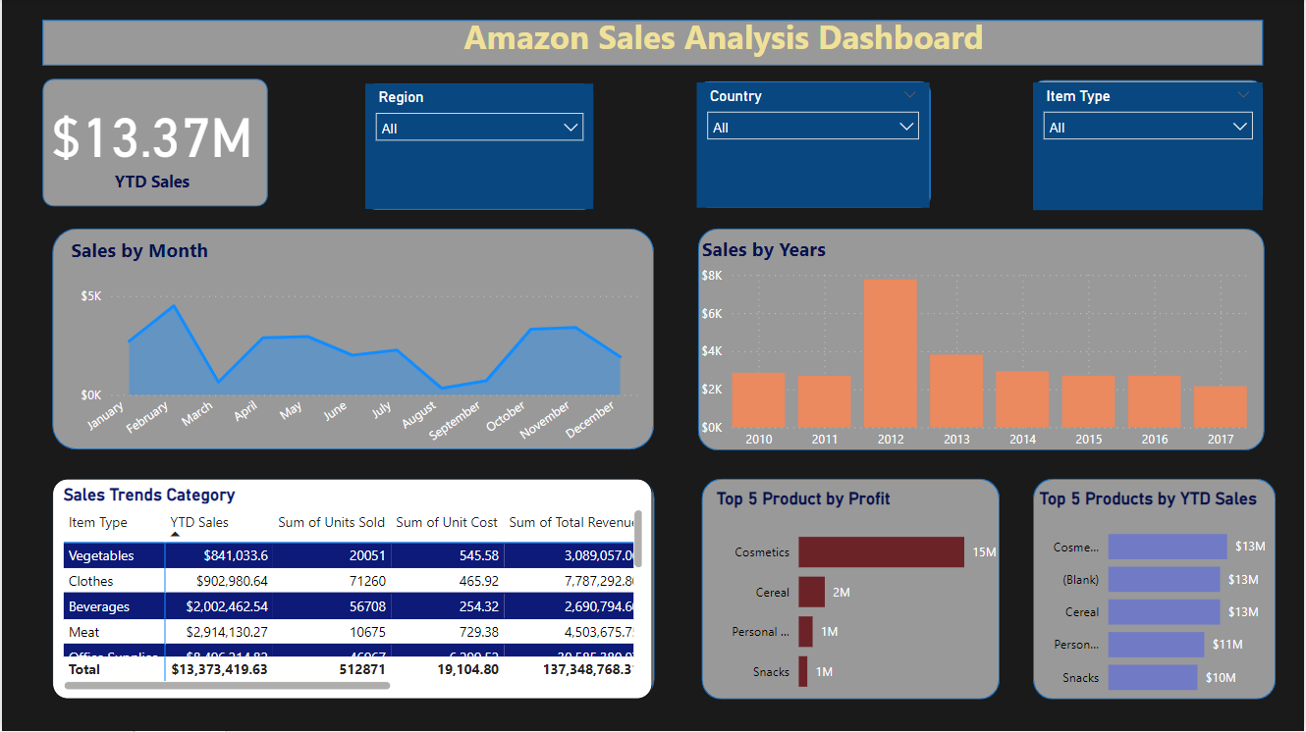
Dashboard

Slide 6
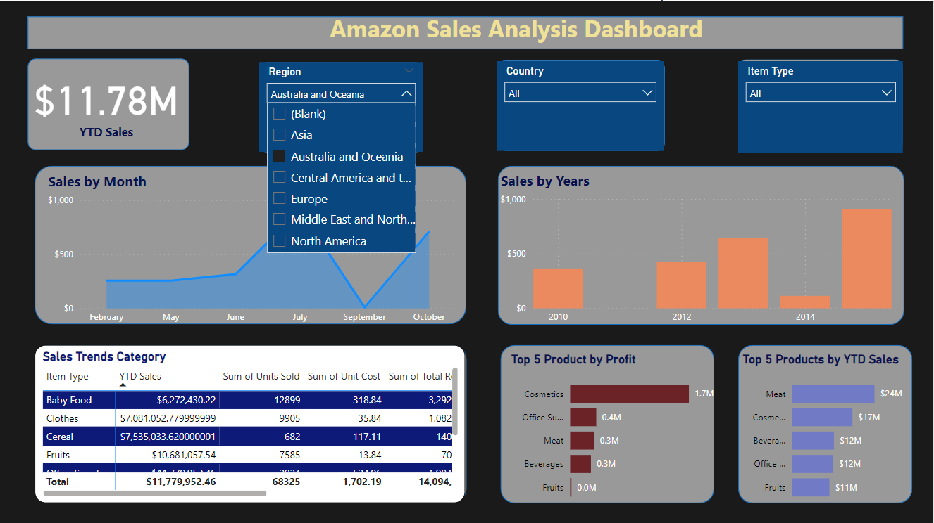
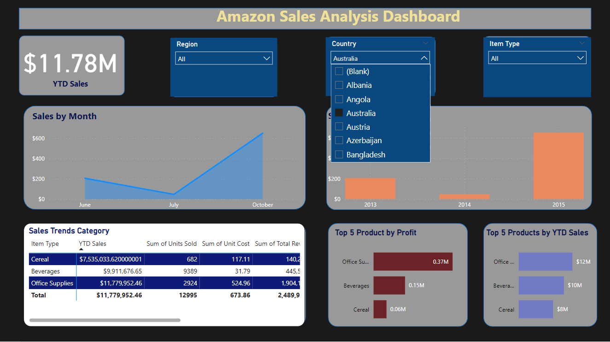
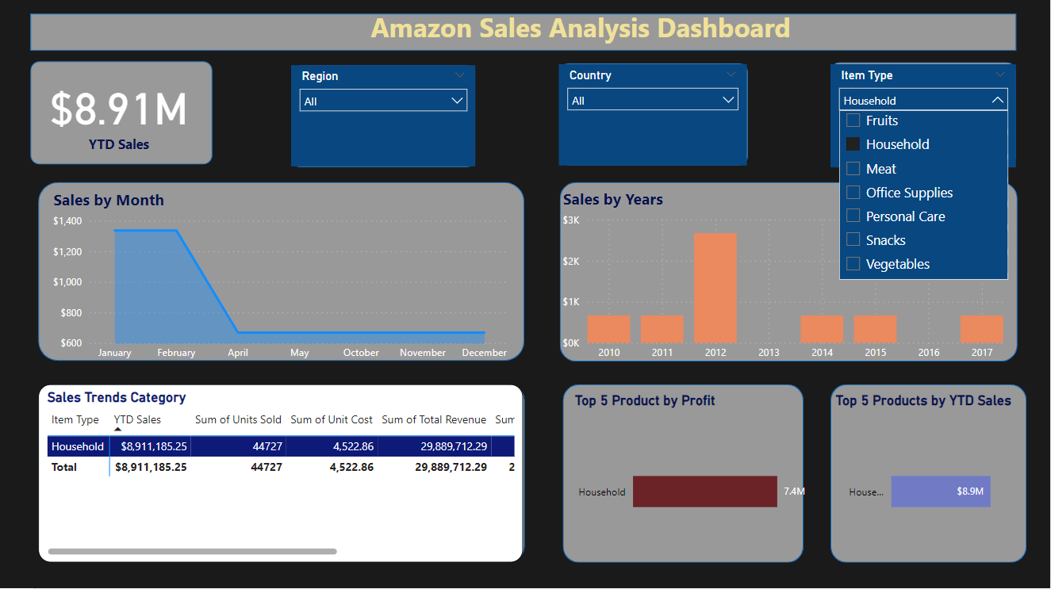
Working Dashboard

Slide 7
Thank you

